Slide 1



Slide 2


Website:
www.https://learningandearningschool.com/register/
Mail:
contact@learningandearningschool.com
Head Office:
Learning & Earning School Ltd.
Yeasin Nagar (Maddha Barera), Bypass Moor, Mymensingh, Bangladesh

Slide 3

Legal Documents

Slide 4

DOCUMENTS

Slide 5


DOCUMENTS

Slide 6

WHAT IS LEARNING & EARNING SCHOOL?
Learning & Earning School Ltd. একটি আধুনিক অনলাইন ও অফলাইন সামাজিক ব্যবসা ভিত্তিক শিক্ষা প্ল্যাটফর্ম, যেখানে সীমাহীন শিক্ষার্থী একসাথে দক্ষতা অর্জন, অনুশীলন ও বাস্তব প্রয়োগের মাধ্যমে শেখে এবং আয়ের প্রায় ৮০% শিক্ষার্থী ও প্রমোটারদের মধ্যে ভাগ করা হয় — শেখা ও আয়ের সম্ভাবনা একসাথে।

Slide 7


Learning & Earning School Ltd.

Slide 8
🎯 Our Mission:
Learning & Earning School Ltd. - প্রতিটি শিক্ষিত মানুষকে অনলাইন প্রশিক্ষণের মাধ্যমে পেশাগত ভাষা, ডিজিটাল সচেতনতা এবং আয়-উপযোগী দক্ষতায় গড়ে তুলতে প্রতিশ্রুতিবদ্ধ। আমরা বিশ্বাস করি — শিক্ষা তখনই পূর্ণতা পায়, যখন তা মানুষের আয়, আত্মনির্ভরতা ও পেশাগত উন্নতির পথ তৈরি করে।

Slide 9

Learning & Earning School Ltd.

Slide 10
🎯 Our Vision:
Learning & Earning School Ltd. - এর লক্ষ্য হলো এমন অফলাইন স্কুল তৈরি করা, যেখানে সকল শিক্ষিত ও বেকার মানুষ বিশ্বব্যাপী জনপ্রিয় সার্টিফিকেট কোর্সসহ প্রয়োজনীয় দক্ষতা শিখে আত্মনির্ভর হবে, দেশের ও বিদেশের কর্মসংস্থানে যুক্ত হবে, বেকারত্ব কমবে এবং বাংলাদেশ অর্থনৈতিকভাবে সমৃদ্ধ হবে।

Slide 11
Learning & Earning School Ltd. -
💡 Tagline:
“From Education to Profession — Learn to Earn.”
💡 মূল বার্তা :
“শিক্ষা থেকে পেশা — শেখার সঙ্গে আয়ের সুযোগ।”

Slide 12
COURSE
Digital Marketing
Spoken English
01. Introduction to Digital Marketing
02. Market & Audience Research
03. Meta Marketing (FB & Instagram)
04. Marketing Content Materials
05. Google My Business (Local SEO)
06. SEO (Search Engine Optimization) 07. Email & ChatGPT Marketing
08. YouTube Marketing & Video SEO
09. LinkedIn & Personal Branding
10. Freelance Marketplace & Portfolio 11. Client Management Practice
12. Payment Gateway & Final Project
01. Basic Grammar Foundations
02. Essential Sentence Structure
03. Practical Speaking Skills
04. Question Formation Techniques
05. Everyday Conversation Mastery
06. Listening & Understanding Practice
07. Confidence & Fluency Development
08. Tense-Based Speaking Structure
09. Common Speaking Expressions
10. Topic-Based Monologue Practice
11. Professional Presentation Skills
12. Advanced Communication Techniques

Slide 13
COURSE
Computer Operation
1. Computer Fundamentals & Basic Operations
2. Operating System (Windows) Management
3. Typing Skills & Productivity Tools
4. Microsoft Word (Document Processing)
5. Microsoft Excel (Data Management & Analysis)
6. Microsoft PowerPoint (Presentation Skills)
7. Internet Browsing & Online Safety
8. Email & Digital Communication
9. File Management & Cloud Storage
10. Basic Graphic Design (Canva/Tools)
11. IT Troubleshooting & Maintenance Basics
12. Freelancing & Online Work Fundamentals

Slide 14
COURSE
Entrepreneurship Development
English for Work
1. Entrepreneurship Mindset
2. Business Opportunities
3. Business Planning & Strategy
4. Startup Legal Framework
5. Financial Management
6. Marketing & Branding
7. Digital Marketing Tools
8. Operations & Supply Chain
9. Risk & Problem Solving
10. Leadership & Team Skills
11. Funding & Investment
12. Business Growth & Sustainability
1. Workplace English Basics
2. Professional Communication
3. Office Etiquette & Team Skills
4. Workplace Speaking Skills
5. Listening & Understanding
6. Business & Industry Vocabulary
7. Email & Business Writing
8. Meetings & Presentation Skills
9. Phone & Virtual Communication
10. Client Handling & Service
11. Interview & Career Skills
12. Advanced Communication & Problem Solving

Slide 15






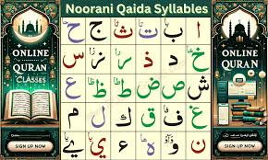
Upcoming Course:
Graphic Design
Kids Spoken
Arabic Language
Japanese Language
Spanish language
Korean Language
Noorani Quran Shikkah

Slide 16
Teacher
Hub
PORTAL
Job
Portal

Slide 17
UPCOMING PROJECT
Top 10 Most Globally In-Demand Practical Skills / Jobs
Skill / Job Global Demand Reason

Slide 18



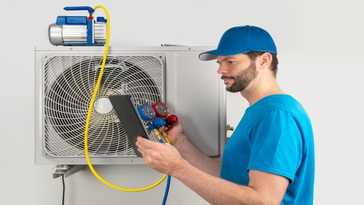


OFFLINE COURSE
Electrician / Electrical Technician
Plumbing & Pipe Fitting Technician
Construction & Welding Technician
HVAC / Cooling & Heating Technician
Professional Driver (LMV/HMV)

Slide 19






OFFLINE COURSE
Housekeeping & Caregiving Assistant
Hospitality & Tourism Professional
Computer Operator & Freelancing
Tailoring & Dress Making Professional
Beauty Therapy & Salon Professional

Slide 20
Why Learning & Earning School?
“Successful people do the same work in different ways”
(সফল ব্যাক্তিরা একই কাজ ভিন্ন ভিন্ন ভাবে করে)

Slide 21
Traditional
System
EXAMPLE
ONLINE
system

Slide 22



Traditional
System
Course costs: ৳10,000
3 month’s accommodation
and meals cost:৳20,000
Total = ৳30,000

Slide 23



ONLINE
system
Online course is only ৳500/1000/1500
12 class (weekly)
Validity: 180 days
Certification

Slide 24
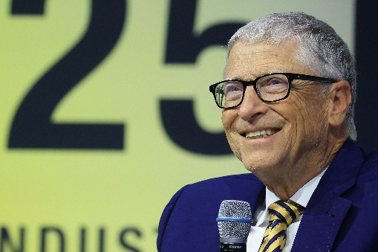

Bill Gates
EXAMPLE
Jeff Bezos

Slide 25

EXAMPLE
-Elon Musk
The World’s First Trillionaire (Projected)

Slide 26
Passive Earning

Slide 27
REWARD
Auto Trainee Allowance
2%
💰 New Enrolment
(1500৳ Fee)
📊 2% Allowance Generated
(30৳)
👨‍🎓 Equal Distribution
Among 2000 Trainees
⚙️ Micro Share per Trainee
≈ 0.001৳
✅ Stops Automatically
at 1500৳ Earned

Slide 28


Pool | Reward
66.67
Pool1
200 BDT
44.44
400 BDT
Pool2
(200)
Pool3 | 800.00BDT
Community Auto Pool
Pool4 | 1,600.00BDT
Pool5 | 3,200.00BDT
1:3
Pool6 | 6,400.00BDT
Left
REWARD
1
Pool7 | 12,800.00BDT
to
Right
Pool8 | 25,600.00BDT
Pool9 | 51,200.00BDT
Pool10 | 102,400.00BDT
66.67
2
200
66.67
3
200
66.67
4
200
Pool11 | 204,800.00BDT
Pool12 | 409,600.00BDT
Pool13 | 819,200.00BDT
Pool14 | 1,638,400.00BDT
Pool15 | 3,276,800.00BDT
Total=65,53,200BDT

Slide 29
Active Earning

Slide 30
Affiliate Program
28%
Reference Earning
20%
Affiliate Earning
8%

Slide 31


20%
Reference Earning
Reference Earning = 20%;
1500x20% = 300TK;
10x300= 3000TK.
Team Work
Reference
Affiliate Earning 8%
Earn
Total Earning
Team-01
10
0.4%
10x6
60
Team-02
100
0.4%
100x6
600
Team-03
1000
0.4%
1000x6
6000
Team-04
10000
0.4%
10000x6
60000
Team-05
100000
0.4%
100000x6
600000
Team-06
1000000
0.4%
1000000x6
6000000
Team-07
10000000
0.4%
10000000x6
60000000
Team:01-10=0.4%=6TK.
Team:11-30=0.2%=3TK.

Slide 32


Enroll=90 Trainee=(RC)=2.8%=42TK.
(3-RC)=JC
REWARD
Rank Royalty
7%
(3-JC)=C
2%
Incentives
(3-C)=SC
2%
(Rising Captain)
15
(Junior Captain)
2.8%
(3-SC)=EC
42
(Captain)
(Senior Captain)
(3-EC)=PC
18
1.2%
(Elite Captain)
(Prime Captain)
(3-PC)=LC
9
0.6%
(Legendary Captain)
0.4%
0.4%
0.4%
0.4%
0.4%
0.4%
(Galaxy Captain)
6
(3-LC)=GC
(Crown Captain)
0
(RC)
(JC)
(C)
(SC)
(EC)
(PC)
(LC)
(GC)
(CC)
(Incentives)
(3-GC)=CC

Slide 33

scouter
Scouter
Union Scouter
1.5%
Qualifications:
Rising Captain(R.C)
Got mail to be a scouter
Form-fill-up (Submit your details)
Approval depends on vacancy and activity
Facility
Balance transfer 0.5%
Scouter Pool 1%=15TK.

Slide 34
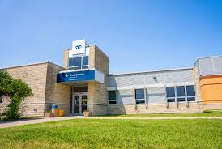
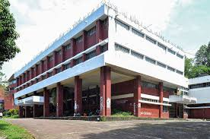
Campus introducer 1%
District Campus
0.5% (7.5TK)
Upazila Campus
0.5% (7.5TK)

Slide 35

CAMPUS EARNING 4%
School
Campus
Balance Transfer
0.5%
Deposit
0.25%
Enroll
0.5%
Pool
1%
Withdraw 2%
District Campus
7.5
3.75
7.5
15
20
1500
1500
Upazila
Campus
7.5
3.75
7.5
15
20
1500
ENROLL:1500
Withraw:1000
Student
Campus=Charge5%=D.C/U.C=2%
*(3%Institution)*
Digital Marketing
Spoken English

Slide 36
Student Withdraw
Once a student earns 100 BDT, they can withdrawals from school at 5% service charge. Example: 100 BDT × 5% = 95 BDT.
Students can withdraw from their district or upazila campus for only 5% BDT service fee.

Slide 37
🌟We’re excited to have you with us. Together, let’s grow, achieve, and make success happen! 🚀
Welcome to a New Journey!
Learning & Earning School Ltd.

